Slide 1
An Introduction to REDCap FOR DATA Collection and Research Project management
Chuck Cleland
November 30, 2017

Slide 2
Main Goals
Think about how to do data collection and manage other study activities better
REDCap
History
Features
Flexibility
Avoiding some pitfalls
Limitations
Where to learn more

Slide 3
Past Data Collection & Project Management Practices
Paper-based data collection followed by error-prone data entry
Complex interview skip patterns not easy to program
Different types of data in different places and formats
Checking for invalid responses only after data collected
Time lag between data collection and availability for analysis
Uploading
Merging
Cleaning
Data collection and project management separated

Slide 4
Wishlist
Quick, intuitive development of interview items
CAPI, ACASI, web surveys, mobile devices
Multiple types of items
Intuitive programming of skip patterns
Easy and secure access to collected data, as it is collected
All or almost all data in one place
Survey responses, signed consent forms, locator, biological testing results, allocated study condition
Data collection integrated with other aspects of research project management
Easy export to external stat software

Slide 5
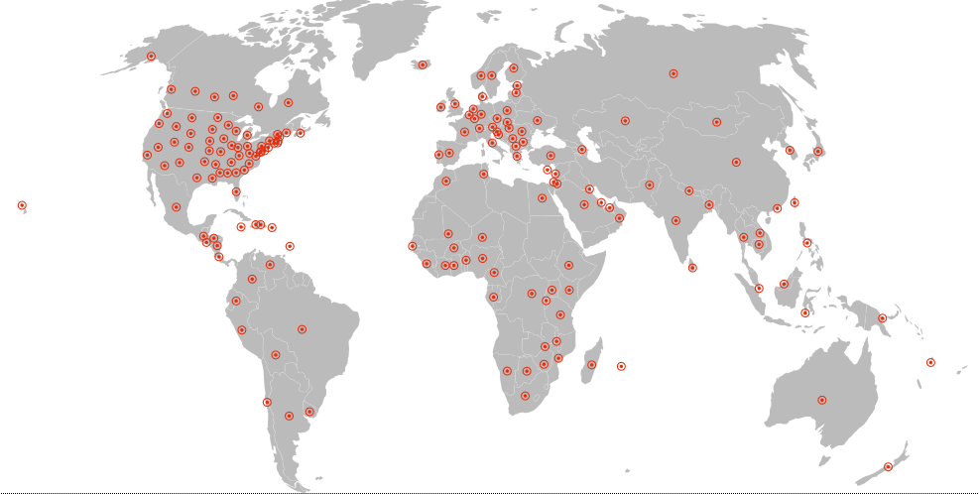
What is REDCap?
Secure web application for building and managing surveys and databases
Used by thousands of institutions in > 100 countries
Can be used to collect almost any kind of data
21 CFR Part 11
Federal Information Security Management Act (FISMA)
HIPAA-compliant

Slide 6
REDCap History
Launched in 2004 at Vanderbilt University
HIPPA compliant secure data collection
User-friendly web-based interface with researcher in control
In 2006, the REDCap Consortium officially launched
Handful of non-profit organizations interested in expanding REDCap’s functionality
Established annual in-person conferences in 2009
Continued to expand REDCap in subsequent years, introducing features to support more diverse types of data collection
REDCap now used for just about any type of data collection you can imagine, across thousands of organizations
Provided at no cost to institutions that join Consortium
But there are infrastructure requirements (PHP web server, MySQL data base server, etc.)

Slide 8
Log In

Slide 9
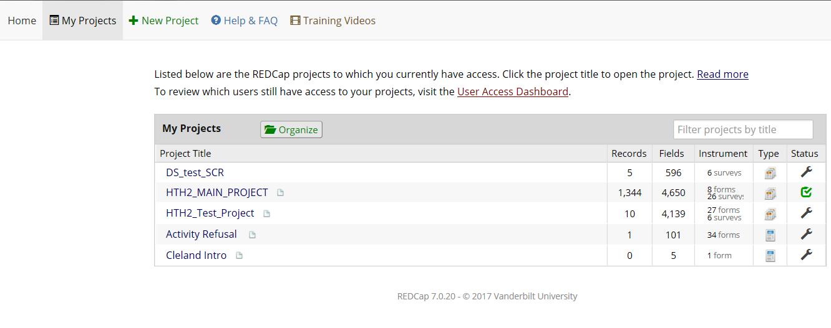
REDCap Homepage
List of user’s projects and basic information about them
Records, fields, instruments, type, and status

Slide 10
Specific Project
Project Name

Slide 11
Left Menu
More added to menu for more complex project types and when additional functionality is enabled

Slide 12
Basic Features & Functionality
Project Development
Build Data Collection Instruments
Online Designer
Data Dictionary
Iterative Testing and Refinement Before Collecting Real Data
Basic Data Entry
Applications
Calendar, export, import, and other functionality

Slide 13
Project Types (Templates)
Type | Description
Basic Demography | Contains a single data collection instrument to capture basic demographic information.
Classic Database | Contains six data entry forms, including forms for demography and baseline data, three monthly data forms, and concludes with a completion data form.
Human Cancer Tissue Biobank | Contains five data entry forms for collecting and tracking information for cancer tissue.
Longitudinal Database (1 arm) | Contains nine data entry forms (beginning with a demography form) for collecting data longitudinally over eight different events.
Longitudinal Database (2 arms) | Contains nine data entry forms (beginning with a demography form) for collecting data on two different arms (Drug A and Drug B) with each arm containing eight different events.
Multiple Surveys (classic) | Contains three surveys and a data entry form. Includes a pre-screening survey followed by two follow-up surveys to capture information from the participant, and then a data entry form for final data to be entered by the study personnel. The project data is captured in classic data collection format.
Multiple Surveys (longitudinal) | Contains three surveys and a data entry form. Includes a pre-screening survey followed by two follow-up surveys, one of which is a questionnaire taken weekly to capture participant information longitudinally over a period of one month. The surveys are followed by a data entry form for final data to be entered by the study personnel. The project data is captured in longitudinal data collection format.
Piping Example Project | Contains a single data collection instrument enabled as a survey, which contains questions to demonstrate the Piping feature.
Project Tracking Database | Contains fifteen data entry forms dedicated to recording the attributes of and tracking and progress of projects/studies.
Randomized Clinical Trial | Contains seven data entry forms for collecting data for a randomized clinical trial. Includes a short demographics form followed by a form where randomization is performed. An example randomization model has already been set up, although randomization allocation tables have not yet been created.
Repeating Instruments | Example classic project showcasing the Repeating Instruments functionality.

Slide 14
Project Type Implications
Different project types will turn different functionality on or off
Selecting a type that is the best fit is an important early step
But effort developing forms and items is not likely to be wasted – once developed, many pieces can be applied to different project types

Slide 15
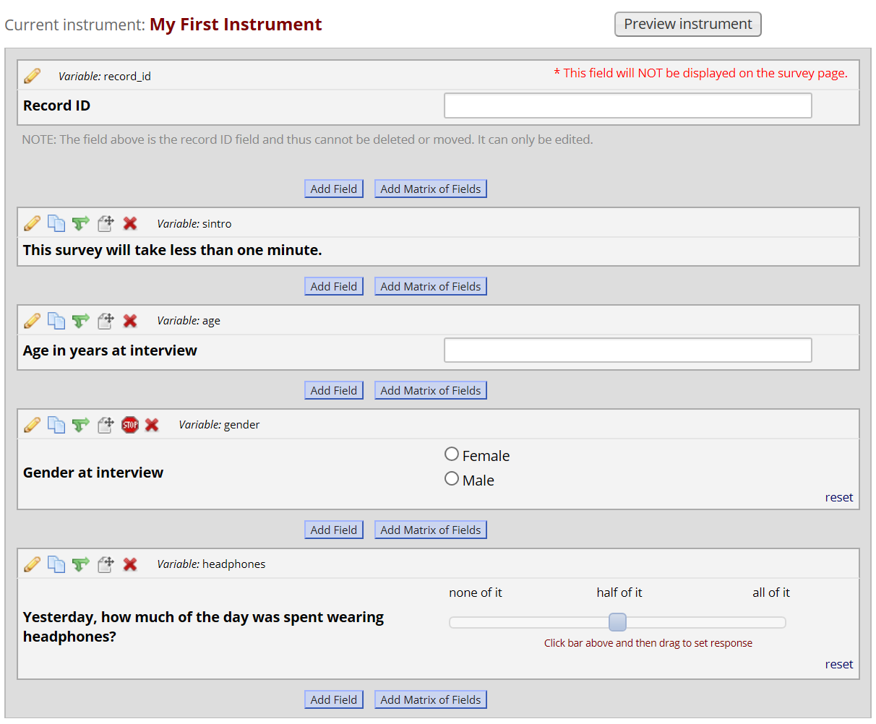
Online Designer
Intuitive web application for building data collection fields

Slide 16
Data Dictionary
Comma-delimited file to specify data fields
Always 18 specific columns
Possibly many rows – one for each field
Edit with MS-Excel
Can make specifying multiple similar items faster
Allows one to use html code for things like bolding and font color
Meta-data for the project
A collection of data dictionaries over time show what changes were made and when

Slide 17
Field Types
Text box (short text, number, date/time, etc)
Notes box (paragraph text)
Calculated field (derived from other fields)
Multiple choice (drop-down list OR radio buttons)
Checkboxes (check all that apply)
Yes/No
True/False
Signature (with mouse, finger, or other device)
Slider/Visual Analog
File upload
Descriptive text
Begin new section (with optional text)

Slide 18
Matrix Field: Setup

Slide 19
Matrix Field: Preview

Slide 20
Matrix Field: Survey Participant View

Slide 21
Participant View of Survey Items

Slide 22
HTML Tags in Field Labels
Center <center>text</center>
Bold <b>text</b>
Italic <i>text</i>
Underline <u>text</u>
Font face <font face=”arial”>text</font>
Font color <font color=”red”>text</font>
Normal font <h2> text</h2>
Large font <h1> text</h1>
Xlarge font <h3> text</h3>
Indent <div style=”margin-left: 20px”>text</div>
Background Color <div style=”background-color:aqua”>color</div>
Background Color <p>green background</p>
Visible line break <hr>
Invisible line break <br/>
Weblink Click <a href=” https://uchicago.edu”>here</a>
Image <img src=”http://imageaddress.jpg”>

Slide 23
Branching Logic
Employed when fields need to be hidden during certain circumstances
For instance, you may want to hide the question “How many hours per week do you watch TV?” until a “Yes” answer is checked for the previous question, “Do you watch TV?”

Slide 24
Branching Logic

Slide 25
Piping
Inject previously collected data into text on a data collection form or survey
Field Label
Field Note
Section Header
Matrix field column headers
Option labels for multiple choice fields (radio, drop-down, checkbox)
Slider field labels (i.e. text displayed above slider bar)
Custom record locking text (if defined, displayed at bottom of form)
Survey Instructions
Survey Completion Text
Survey invitation emails (sent via Participant List or Automated Invitations) - includes both subject and message
Custom text displayed at top of Survey Queue
Inside the URL for a survey's 'Redirect to a URL' setting
All you need to do to pipe a data value into any of the valid places listed above is insert into your text the variable name inside square brackets

Slide 26
Data Validation
Specify constraints on data entry, with a message delivered when invalid values are entered
For example, one could constrain age in years to be an integer between 1 and 99
There are built-in ways to valid things like phone numbers, dates, and email addresses

Slide 27
Data Validation

Slide 28
Data Entry

Slide 29
Data Entry

Slide 30
Data Entry

Slide 31
Survey Links
It is possible to send participants a link to complete surveys
A way to collect data with no user login required
One way to think about it
Survey link = ACASI
Data entry via a project user = CAPI

Slide 32
Personalized Survey Invitations
Setup your Survey Instrument via the Online Designer
Survey Instrument can include items participants do not see
For every non-survey field, add the Action Tag @HIDDEN-SURVEY in the Field Annotation box
Designate an email field to use for invitations
Add your participants’ information in the non-survey fields (e.g., name, email address)
Manage Survey Participants Compose Survey Invitations
In the message body, using square brackets, pipe in the field name containing the personalized information

Slide 33
REDCap Applications
Calendar
Data exports, reports, and stats
Data import tool
Data comparison tool
Logging
Field comment log
File repository
User rights
Data quality
REDCap Mobile App
Supplemental detail: Move from development to production

Slide 34
Data Export

Slide 35
Reports
Show data fields to understand collected data and facilitate project management
Four steps to building a report
Select users who can access the report
Select data fields to include in the report
Select cases to include using logic applied to data fields (e.g., only show female participants)
Select data fields used to order the results (e.g., sort report by age from youngest to oldest)

Slide 36
Randomization
Randomization module randomly assigns participants to specific study groups
Define your randomization model
Download template allocation tables (as Excel/CSV files)
Upload your allocation table (CSV file)
Can be stratified by one or more variables collected before the randomization step
User rights functionality can control which users are allowed to randomize
After the value of the random group is assigned, the random group field becomes read-only and the value can not be changed (by design!)

Slide 37
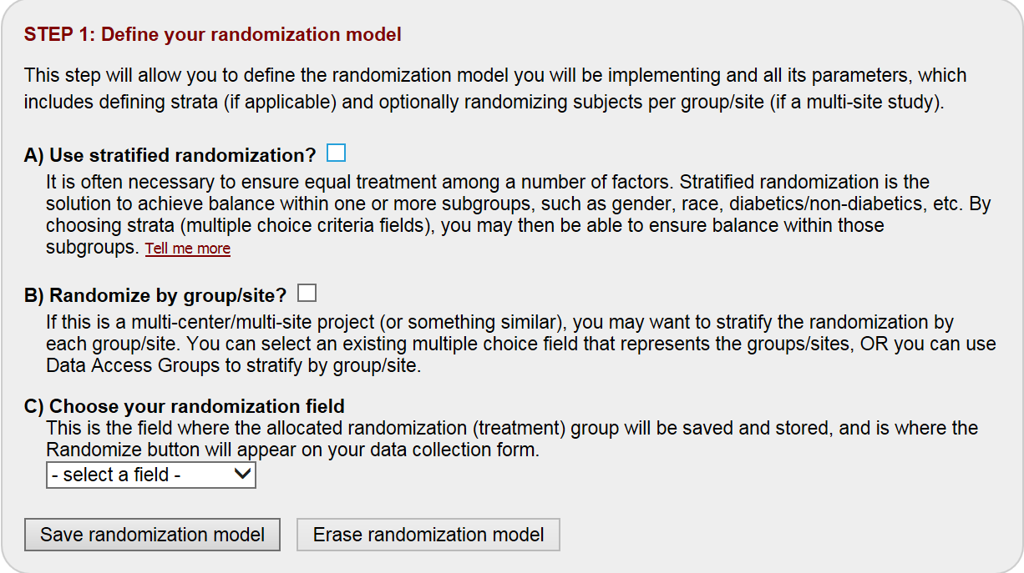
Randomization Module
Step 1 – select randomization model

Slide 38
Randomization Module
Step 2 – download a template to understand allocation table structure

Slide 39
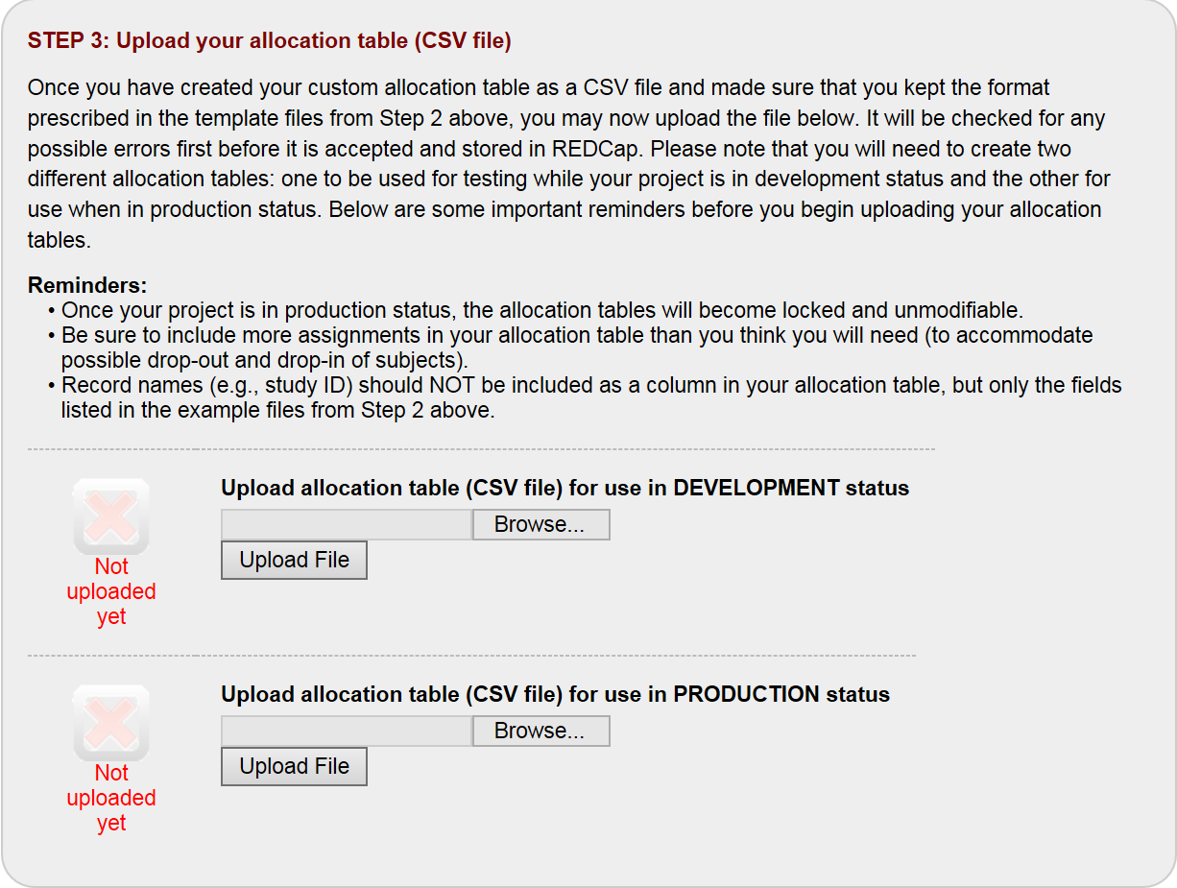
Randomization Module
Step 3 – upload your custom allocation table

Slide 40
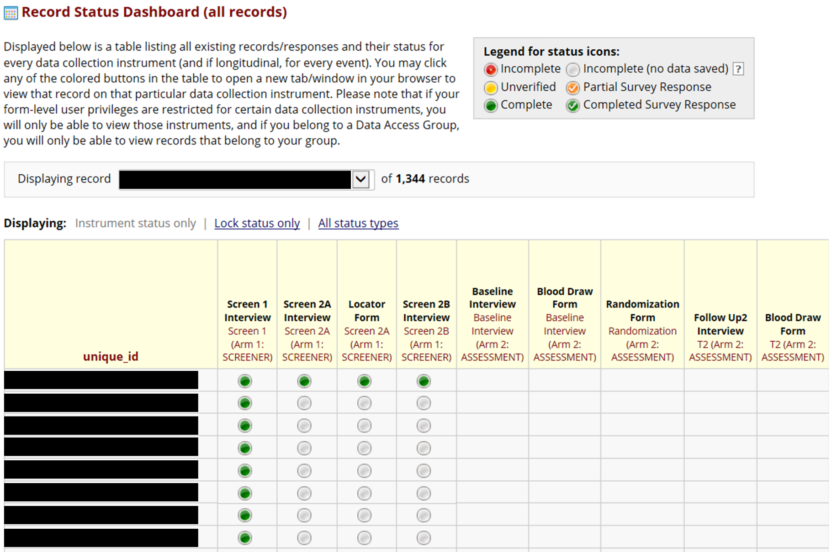
Record Status Dashboard
What assessments have been completed?

Slide 41
Scheduling Events
The Calendar application can be used as a project calendar within this project to help organize your schedule and keep track of any upcoming events
It will allow you to add or modify calendar events and then view them either in a daily, weekly, or monthly format below
To add a new note or calendar event to any day, click +New at the top of that day's box to begin entering the information

Slide 42
Calendar
Calendar tracks events in your study and can be used for data entry
Functionality depends on the project structure
Possible to link a calendar event to a particular record
Record-specific events can be used to access data collection instruments
In longitudinal projects, scheduling module uses the longitudinal event grid to populate the calendar with record-specific events
Record-specific events are linked to data collection instruments (administer instrument X, at time Y, to participant I)

Slide 44
Locking Records
Record locking freezes data, ensuring that users don’t accidentally modify it without authorization
This controls data entry and is commonly used to prepare for statistical analysis or to archive final datasets
Only instruments are locked
It is not possible to lock individual fields
The project status and form status do not affect locking
This feature can be used at any time, with any records
Locking permissions are controlled on the User Rights page
Unlocking allows data to be changed as usual

Slide 45
Data Access Groups
Team members can have access to different or be restricted from different parts of the project
Each member of the project enters REDCap with a unique user name and login
Project administrators can control who may execute specific tasks on the project (e.g., deleting records)
For example, you would not want a staff member responsible for collecting data in the field to have the ability to alter the randomization table
Staff involved with intervention delivery may access different forms than staff administering interviews

Slide 46
Mobile App
Collect data in a mobile app on an iPhone, iPad, or Android phone or tablet
Offline data collection for environments with poor Internet connectivity
Must be used alongside REDCap itself

Slide 48
Data Resolution Workflow
A workflow for documenting the process of resolving issues with data in the project
Queries can be generated
An open data query implies that there is an issue with a data value that needs to be resolved
Any user with 'respond' privileges will be able to respond to an open query
Once a query has been responded to, a user with 'close' privileges may close the query, after which it will be considered resolved

Slide 49
REDCap API
API is 'Application Programming Interface'
REDCap API is an interface that allows external applications to connect to REDCap remotely
Used for programmatically retrieving or modifying data or settings within REDCap
Automated data imports/exports from a specified REDCap project
In order to use the REDCap API for a given REDCap project, you must first be given a token by the administrator that is specific to your username for that particular project

Slide 50
REDCap Shared Library
Repository for REDCap data collection instruments and forms
Curated, approved for inclusion by the REDCap Library Oversight Committee (REDLOC) after review for relevance, accuracy in function and coding, and copyright issues
About 1700 instruments
Can search by keyword
https://redcap.vanderbilt.edu/consortium/library/search.php

Slide 51
Project Testing
Does the instrument look the way you want
Does the branching logic (skip patterns) work correctly
Do calculated variables return correct values
Real project data should not be entered while in development mode
Once the project has undergone thorough testing, you change from development to production status

Slide 52
Development vs. Production
Development is designed for iterative building of instruments and other project functionality
Rapidly add, remove, reorder instruments and items
Production is designed for real data collection

Slide 53
Avoiding Pitfalls
Deleting Records
Renaming Fields
Enumeration Changes
Not Testing your Project
Not Moving to Production Status
Calculated Fields

Slide 54
Deleting Records
Three options
OPTION 1 will delete the record ENTIRELY from ALL forms (and events in longitudinal projects)
OPTION 2 will delete the record from only the specific form chosen
OPTION 3 will delete the record from only the specific event chosen

Slide 55
Renaming Fields
Once the project is in production with live data collected, there is no renaming of fields because the field names are linked directly to the REDCap data.
If a new field name is absolutely necessary, you will need to export the data, create a new field with the new name, upload the data to the new field, and delete the old field with the old name.
The field name will also need to be manually changed in other places (e.g., Branching logic, Calculations, Reports)

Slide 56
Enumeration Changes
Once the project is in production with live data collected, Dropdown list, Radio Buttons, and Check Boxes should not be renumbered because the numbers are linked directly to the REDCap data
The field choices can be in any order regardless of the number assigned, as the choices will be shown in the order listed rather than numeric order
For example, let’s start with:
1, Allentown 2, Beaumont 3, Carson
Say you need to add “Bakersville”. Do not add as follows:
1, Allentown 2, Bakervsille 3, Beaumont 4, Carson
Instead, add “Bakersville” as follows (without changing numbers):
1, Allentown 4, Bakervsille 2, Beaumont 3, Carson

Slide 57
Not Testing Your Project
It is important to test the essential components of your project before moving it into production
Create a few test records and entering some data for each to ensure that your data collection instruments look and behave how you expect, especially branching logic and calculations
Review your test data by creating reports and exporting your data to view in Excel or a statistical analysis package
If you have surveys, complete the surveys as if you were a participant by using the Public Survey Link or Participant List by sending a survey invitation to yourself
The best way to test your project is to use it as if you were entering real production data, and it is always helpful to have team members or colleagues take a look at your project to get a fresh set of eyes looking at it

Slide 58
Not Moving to Production Mode
Once you have designed and tested your project, you should move your project to production for very important reasons:
Your data will be safer. You can safely make changes to your project in “Draft Mode” while leaving the project undisturbed until the changes are actually applied.
Renaming of fields and/or events, and renumbering of coded fields (drop-down, radio button, check boxes) will come with warning messages.
Changes to forms that might compromise your data will be reviewed and approved by the Administrator before they are committed to the project.
REDCap keeps a copy of past Data Dictionaries so you can refer back to them if there are ever any questions.

Slide 59
Calculated Fields
Calculations should be considered a tool not data. Calculations should be reapplied during data analysis.
Do not reference calculated fields within calculated fields. When multiple calculations are performed, the order of execution is determined by the alphabetical order of the associated field names.
Multiple calculations on a form. Order of execution is determined by the alphabetical ordering of associated variable names.
Problem: Here, Calculation 2 will occur before Calculation 1!
Calculation 1 [weight_met] =[weight]*.45359237
Calculation 2 [BMI]=[weight_met]/([height]^2) Solutions:
Best solution
calculate BMI in one step
Other solution
rename variable to change order

Slide 60
Calculated Fields (Cont.)
Avoid using "today" in calculated fields. This is because every time you access and save the form, the calculation will run. So if you calculate the age as of today, then a year later you access the form to review or make updates, the age as of "today" will also be updated (+1 yr). Instead, calculate ages off of another field (e.g. screening date, enrollment date).
For longitudinal projects, the unique event name must be prepended (in square brackets) to the beginning of the variable name (in square brackets) specified in the equation. For example: [enrollment_arm_1][weight]/[visit_weight] Presuming this calculated field exists on a form that is utilized on multiple events, it will always perform the calculation using the value of weight from the Enrollment event while using the value of visit_weight for the current event the user is on.

Slide 61
REDCap Limitations
Even though no cost, need institutional support
IT infrastructure and administrator
Working across institutions
Occasional, announced maintenance of server makes REDCap unavailable for a few hours
Exporting scheduled dates
Needs to rely on outside functionality to send SMS to participants

Slide 62
Resources to Learn More
Task-specific videos inside REDCap
Nearly every piece of REDCap has a training video embedded inside the application
Create a project and explore away in development mode
http://project-redcap.org/
NYU Health Sciences Library Data Services
Basic and advanced workshops
Consultations on REDCap form building
http://cri.uchicago.edu/redcap-training/
https://www.iths.org/investigators/services/bmi/redcap/
Harris, P. A., Taylor, R., Thielke, R., Payne, J., Gonzalez, N., & Conde, J. G. (2009). Research electronic data capture (REDCap)--a metadata-driven methodology and workflow process for providing translational research informatics support. Journal of biomedical informatics, 42(2), 377-381.
Blumenberg, C., & Barros, A. J. (2016). Electronic data collection in epidemiological research. The use of REDCap in the Pelotas birth cohorts. Applied clinical informatics, 7(3), 672-681.

Slide 63
Questions

